Slide 1
3D Photography
Sensors

Slide 2
Perspective projection

Slide 3
Pinhole & the Perspective Projection
(x,y)
SCREEN
SCENE
Is there an image being formed on the screen?

Slide 4
Pinhole Camera
“Camera obscura” – known since antiquity
Image plane
Image
Pinhole
Object
Pinhole camera

Slide 5
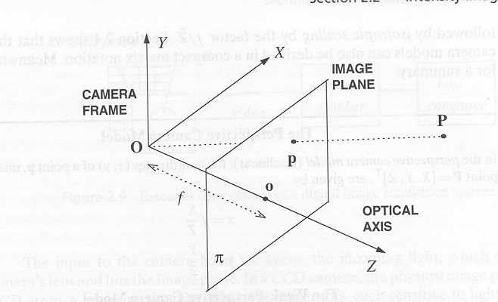
Perspective Camera
From Trucco & Verri
r
r’
(x,y,z)
(X,Y,Z)
Center of
Projection
r =[x,y,z]^{T}
r’=[X,Y,Z]^{T}
r/f=r’/Z
x=f * X/Z
y=f * Y/Z
z=f
f: effective focal length:
distance of image plane from O.

Slide 6
Magnification
From Trucco & Verri
(x,y)
(X,Y,Z)
d
Center of
Projection
d’
(x+dx,y+dy)
(X+dX,Y+dY,Z)
x/f=X/Z
y/f=Y/Z
(x+dx)/f=(X+dX)/Z
(y+dy)/z=(Y+dY)/Z
=>
dx/f=dX/Z
dy/f=dY/Z

Slide 7
Magnification
From Trucco & Verri
(x,y)
(X,Y,Z)
d
Center of
Projection
d’
(x+dx,y+dy)
(X+dX,Y+dY,Z)
Magnification: |m|=||d’||/||d||=|f/Z|
or m=f/Z
m is negative when image is inverted…

Slide 8
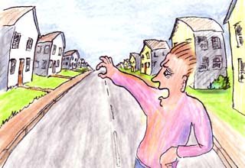
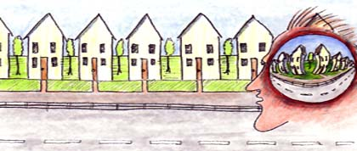
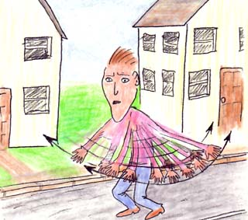
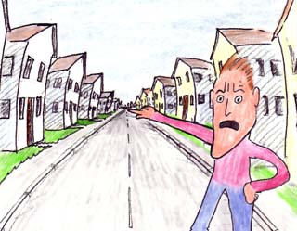
Implications For Perception*
Same size things get smaller, we hardly notice…
Parallel lines meet at a point…
* A Cartoon Epistemology: http://cns-alumni.bu.edu/~slehar/cartoonepist/cartoonepist.html

Slide 9
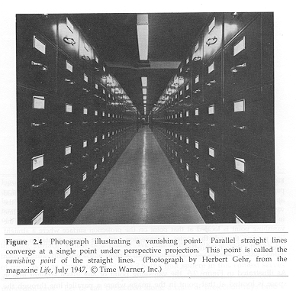
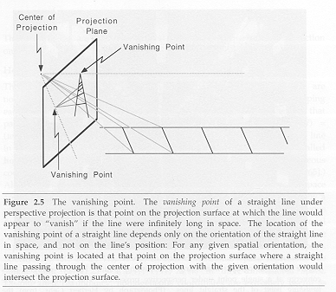
Vanishing Points
(from NALWA)

Slide 10
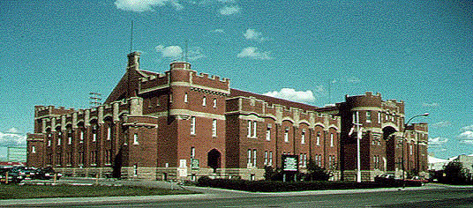
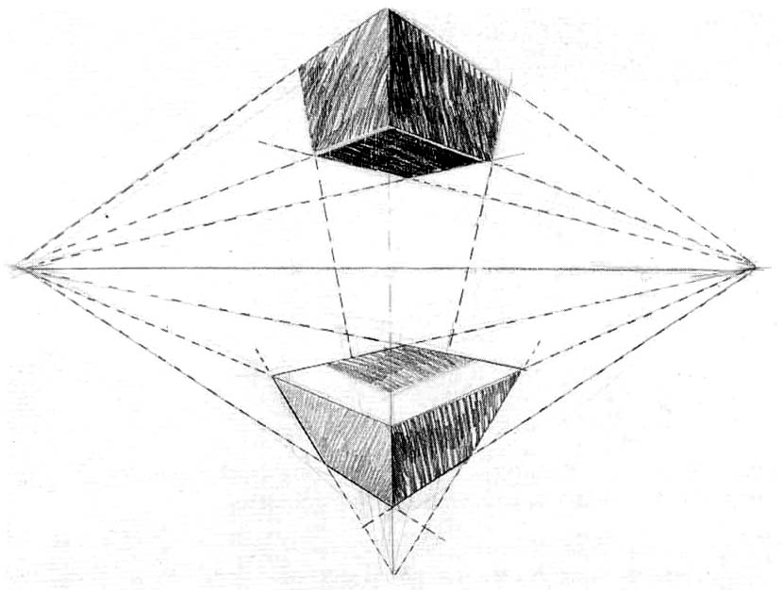
Vanishing points
H
VPL
VPR
VP₁
VP₂
Different directions correspond
to different vanishing points
VP₃
Marc Pollefeys

Slide 11
3D is different…

Slide 12
3D Data Types: Volumetric Data
Regularly-spaced grid in (x,y,z): “voxels”
For each grid cell, store
  Occupancy (binary: occupied / empty)
  Density
  Other properties
Popular in medical imaging
  CAT scans
  MRI

Slide 13
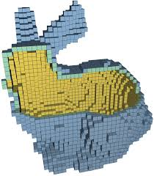
Voxelized example

Slide 14
3D Data Types: Surface Data
Polyhedral
  Piecewise planar
  Polygons connected together
  Most popular: “triangle meshes”
Smooth
  Higher-order (quadratic, cubic, etc.) curves
  Bézier patches, splines, NURBS, subdivision surfaces, etc.

Slide 15
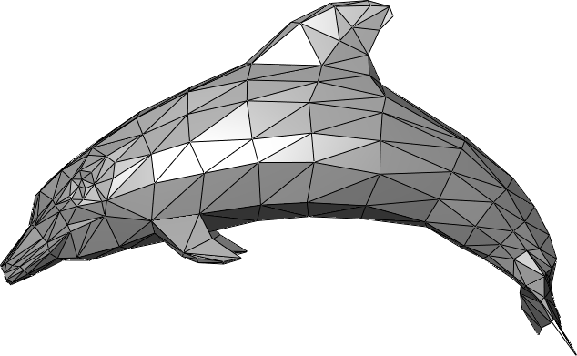
Example of triangle mesh

Slide 16
2½-D Data
Image: stores an intensity / color along
each of a set of regularly-spaced rays in space
Range image: stores a depth along
each of a set of regularly-spaced rays in space
Not a complete 3D description: does not
store objects occluded (from some viewpoint)
View-dependent scene description

Slide 17
2½-D Data
This is what most sensors / algorithms
really return
Advantages
  Uniform parameterization
  Adjacency / connectivity information
Disadvantages
  Does not represent entire object
  View dependent

Slide 18
2½-D Data
Range images
Range surfaces
Depth images
Depth maps
Height fields
2½-D images
Surface profiles
xyz maps
…

Slide 19
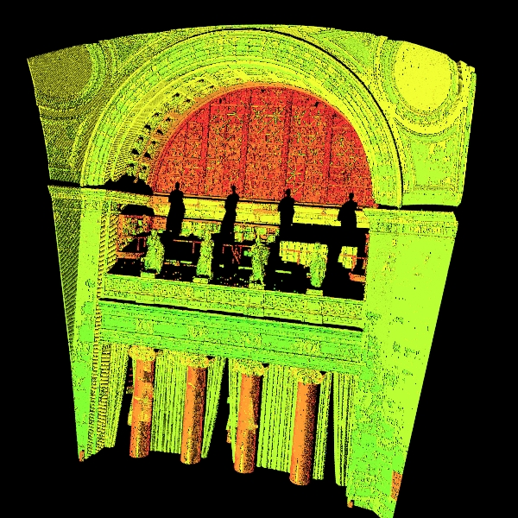
Example of range image

Slide 20
Point Clouds
A collection of 3D points
Order does not matter
Usually the concatenation of various range images

Slide 21
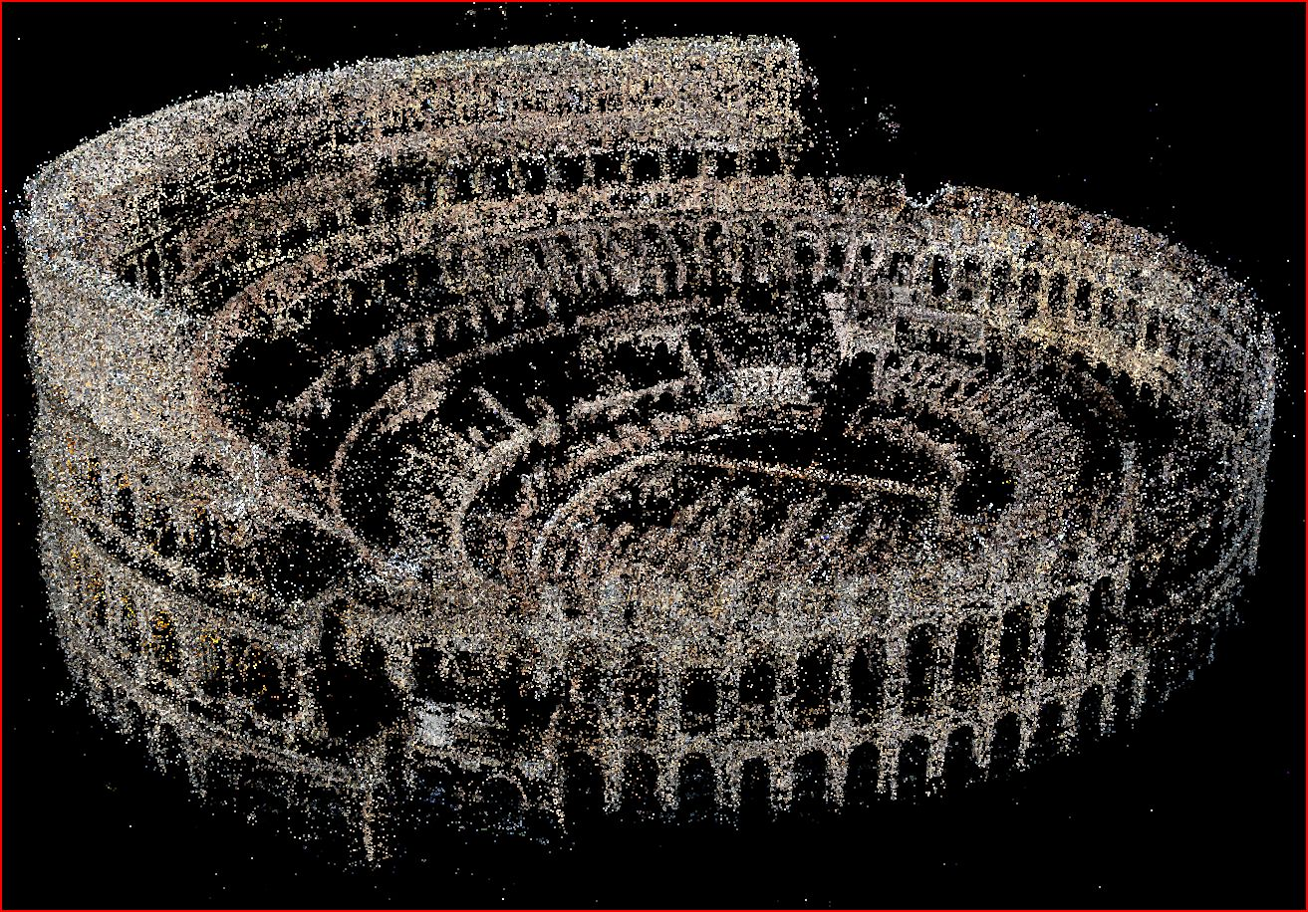
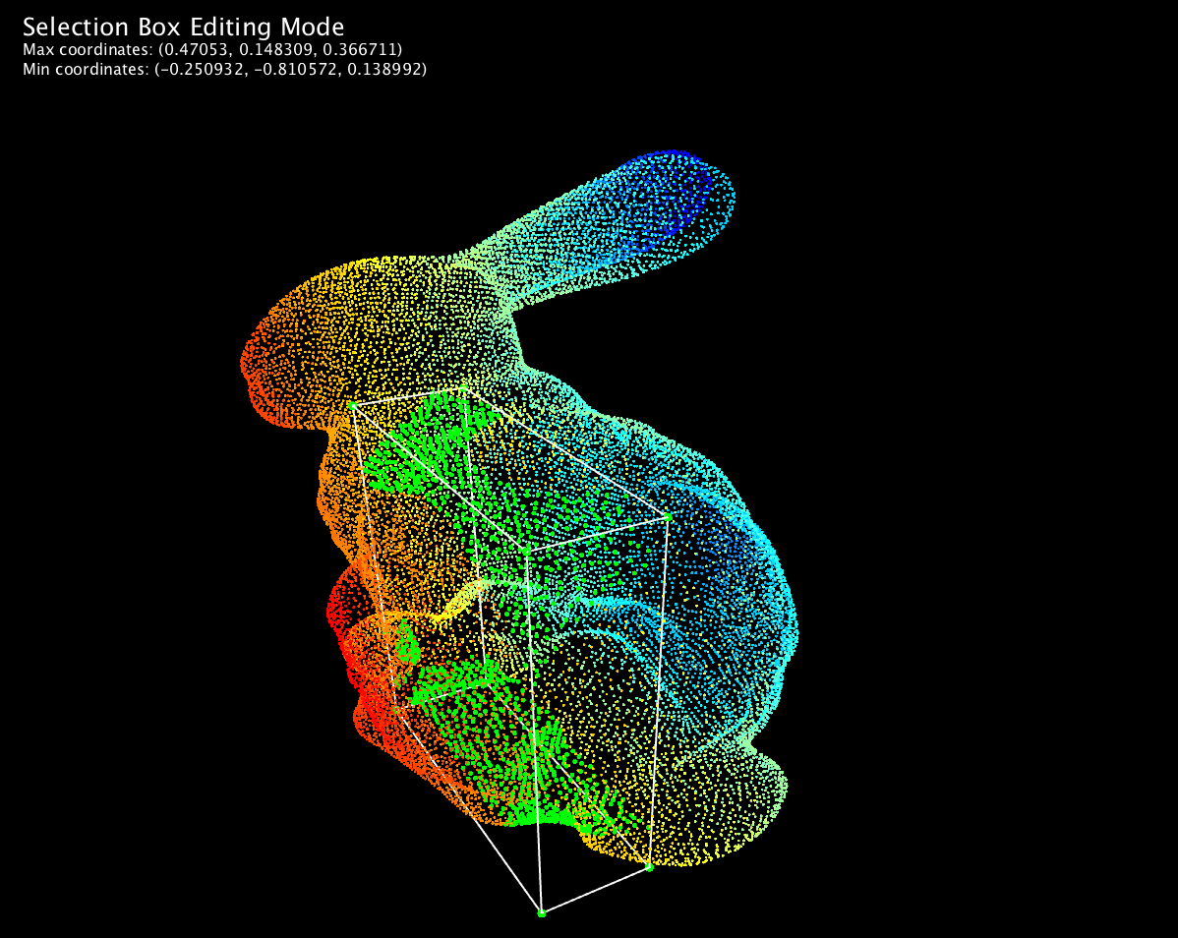
Example point clouds

Slide 22
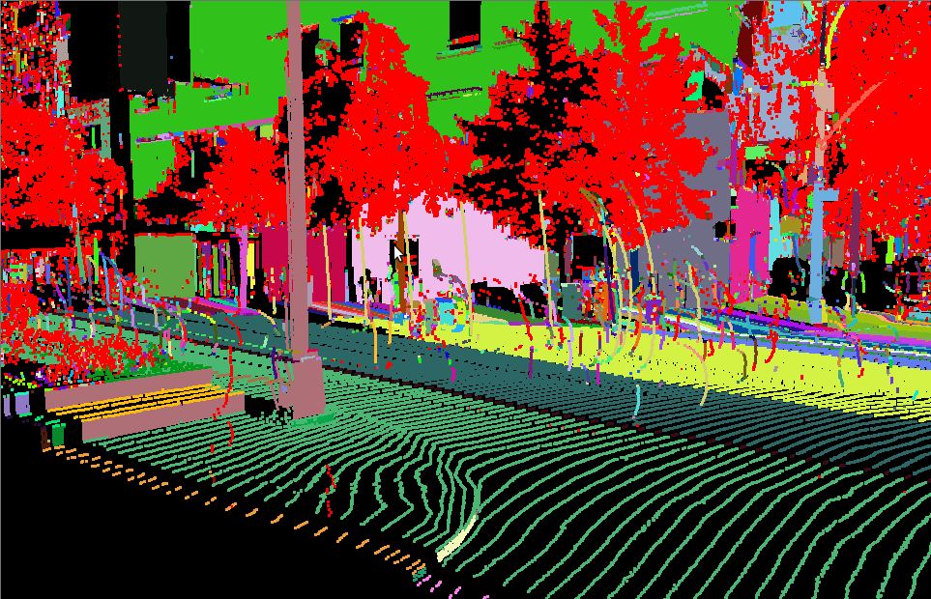
Example of point clouds

Slide 23
Range Acquisition Taxonomy
Mechanical (CMM, jointed arm)
Inertial (gyroscope, accelerometer)
Contact
Ultrasonic trackers
Magnetic trackers
Industrial CT
Range
acquisition
Transmissive
Ultrasound
MRI
Radar
Non-optical
Reflective
Sonar
Optical

Slide 24
Range Acquisition Taxonomy
Shape from X:
stereo
motion
shading
texture
focus
defocus
Passive
Optical
methods
Active variants of passive methods
Stereo w. projected texture
Active depth from defocus
Photometric stereo
Active
Time of flight
Triangulation

Slide 25
Optical Range Acquisition Methods
Advantages:
  Non-contact
  Safe
  Usually inexpensive
  Usually fast
Disadvantages:
  Sensitive to transparency
  Confused by specularity and interreflection
  Texture (helps some methods, hurts others)

Slide 26
Stereo
Find feature in one image, search along epipolar line in other image for correspondence

Slide 27
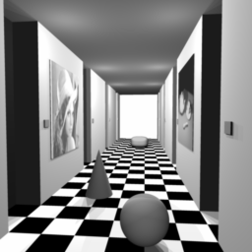
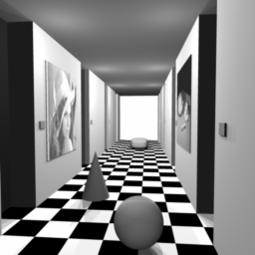
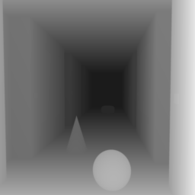
Stereo Vision
depth map

Slide 28
Triangulation
Z-axis
P
Fixation
Point:Infinity.
Parallel
optical axes.
cl
Z
cr
pl
pr
f
X-axis
Ol
Or
T
Left Camera
Right Camera
Calibrated Cameras
Similar triangles:
d:disparity (difference in retinal positions).
T:baseline.
Depth (Z) is inversely proportional to d (fixation at infinity)

Slide 29
Traditional Stereo
Inherent problems of stereo:
    Need textured surfaces
    Matching problem
    Baseline trade-off
    Unstructured point set
However
  Cheap (price, weight, size)
  Mobile
  Depth plus Color
Sparse estimates
Unreliable results

Slide 30
Why More Than 2 Views?
Baseline
  Too short – low accuracy
  Too long – matching becomes hard

Slide 31
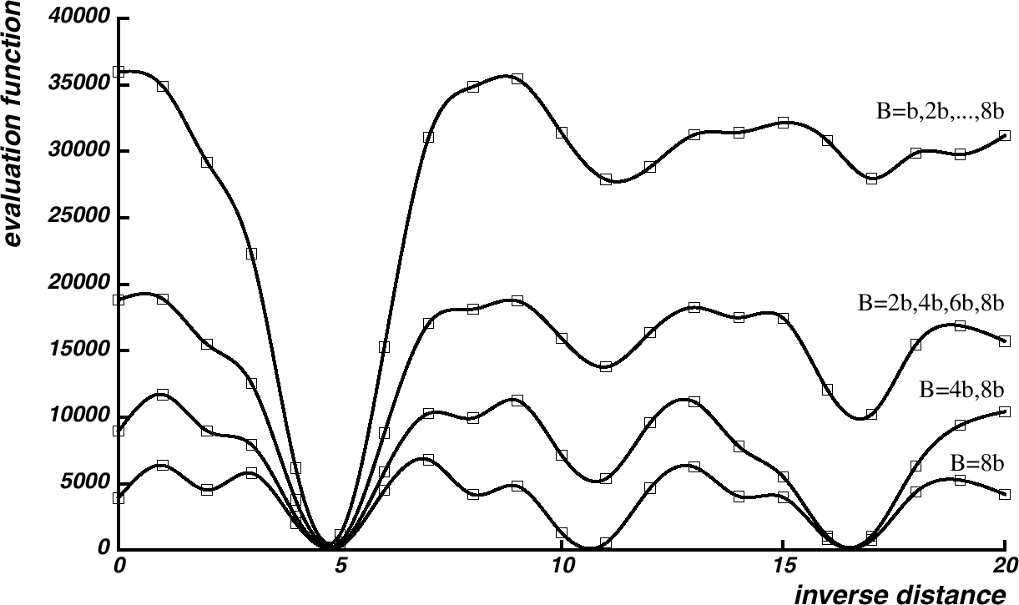
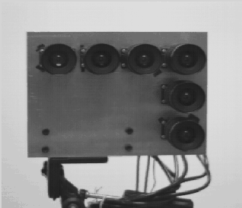
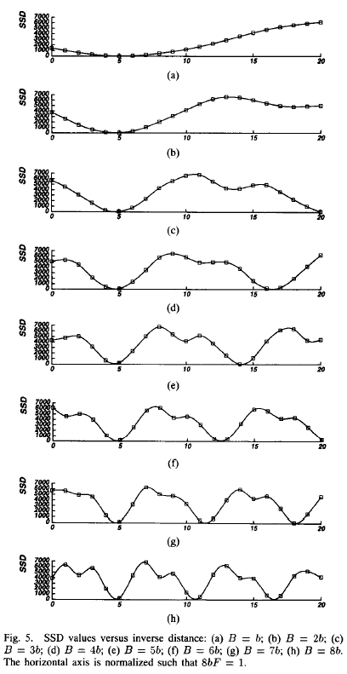
Multibaseline Stereo
[Okutami & Kanade]

Slide 32
Shape from Motion
“Limiting case” of multibaseline stereo
Track a feature in a video sequence
For n frames and f features, have
2⋅n⋅f knowns, 6⋅n+3⋅f unknowns

Slide 33
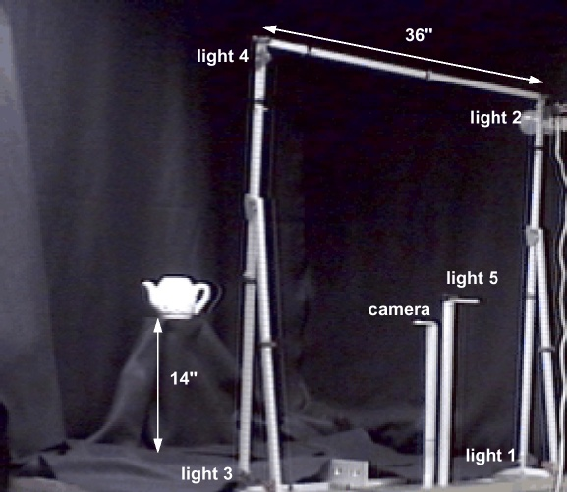
Photometric Stereo Setup
[Rushmeier et al., 1997]

Slide 34
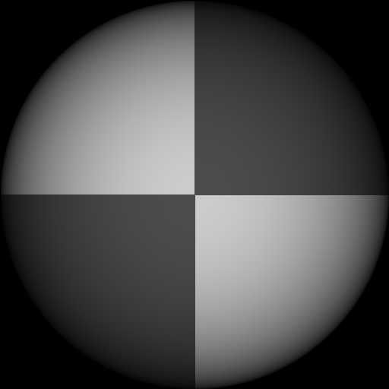
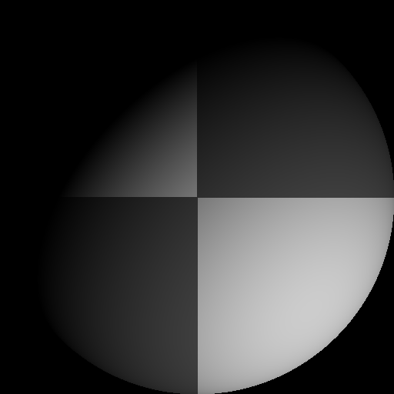
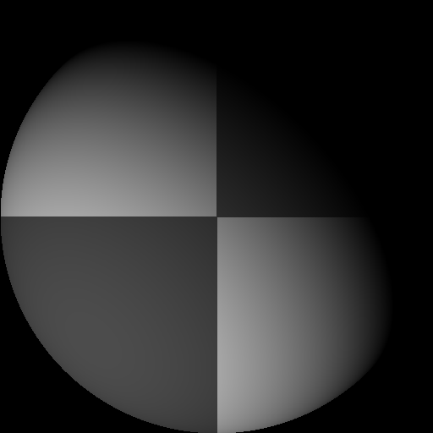
Photometric Stereo
Use multiple light sources to resolve ambiguity
In surface orientation.
Note: Scene does not move – Correspondence
between points in different images is easy!
Notation: Direction of source i: or
Image intensity produced by source i:

Slide 35
Lambertian Surfaces (special case)
Use THREE sources in directions
Image Intensities measured at point (x,y):
orientation
albedo

Slide 36
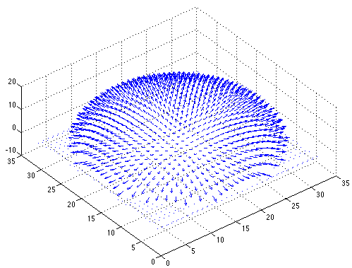

Photometric Stereo: RESULT
INPUT
orientation
albedo

Slide 37
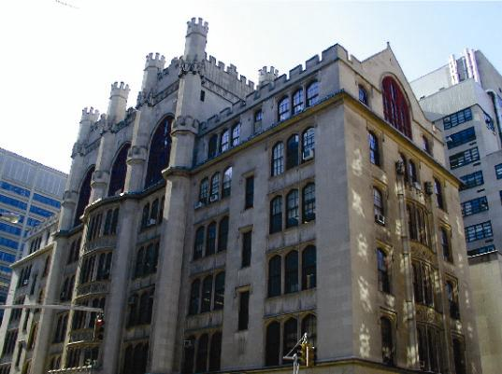
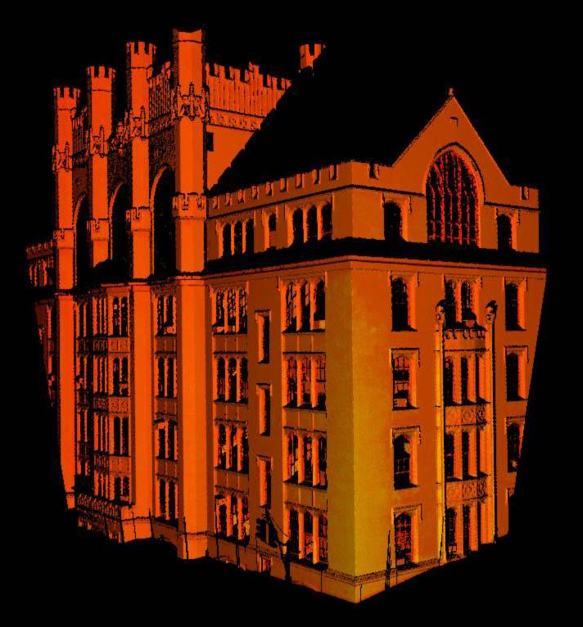
Data Acquisition Example
Range Image of same
building. One million 3D points.
Pseudocolor corresponds to laser
intensity.
Color Image of Thomas Hunter
Building, New York City.

Slide 38
Time-of-flight scanners
Also known as LIDAR
Light Detection And Ranging

Slide 39
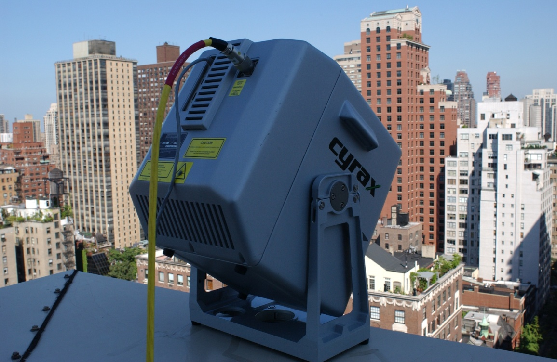
Data
Acquisition
Spot laser scanner.
Time of flight.
Max Range: 100 meters.
Scanning time: 16 minutes
for one million points.
Accuracy: ~6mm per range point

Slide 40
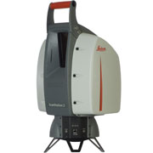
Data
Acquisition
Leica ScanStation 2
Spherical field of view.
Registered color camera.
Max Range: 300 meters.
Scanning time: 2-3 times faster
Accuracy: ~5mm per range point

Slide 41
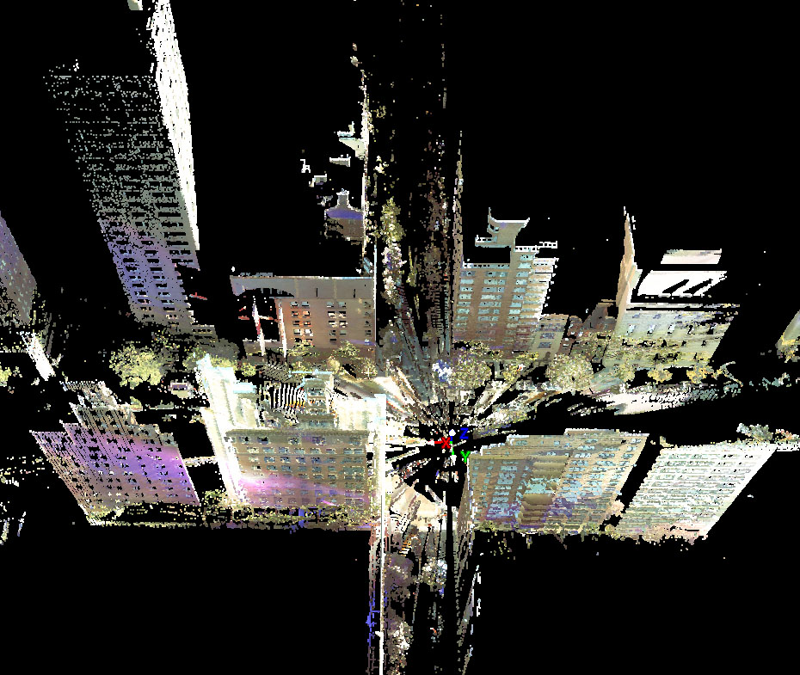
Data Acquisition, Leica Scan Station 2, Park Avenue and 70th Street, NY

Slide 42
Cyclone view and Cyrax Video

Slide 43
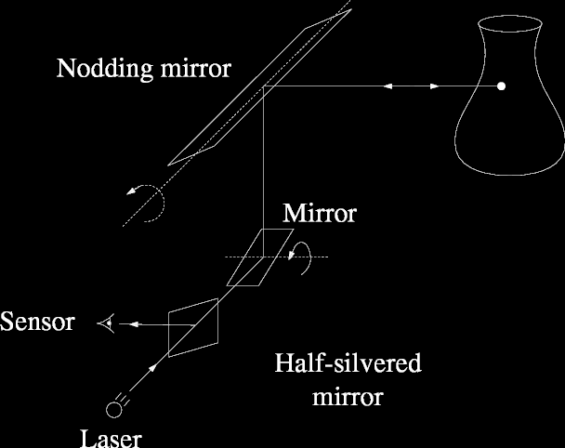
Pulsed Time of Flight
Send out pulse of light (usually laser),
time how long it takes to return

Slide 44
Pulsed Time of Flight
Advantages:
  Large working volume (more than 100 m.)
Disadvantages:
  Not-so-great accuracy (at best ~5 mm.)
    Requires getting timing to ~30 picoseconds
    Does not scale with working volume
Often used for scanning buildings, rooms, archeological sites, etc.

Slide 45
Data Acquisition, Leica Scan Station 2, Park Avenue and 70th Street, NY

Slide 46
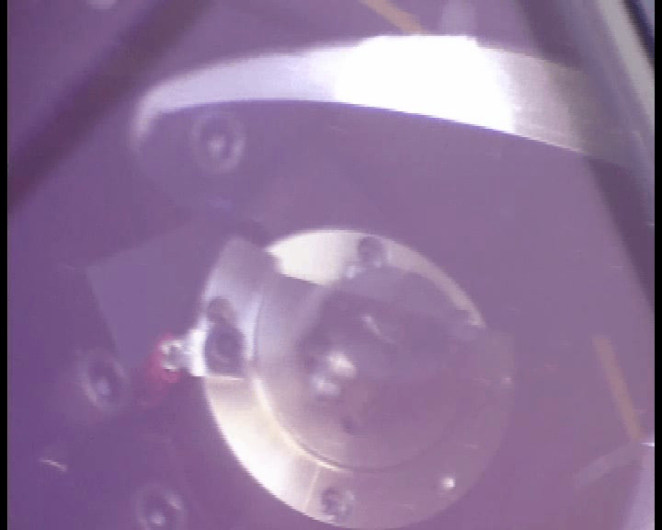
Video

Slide 47
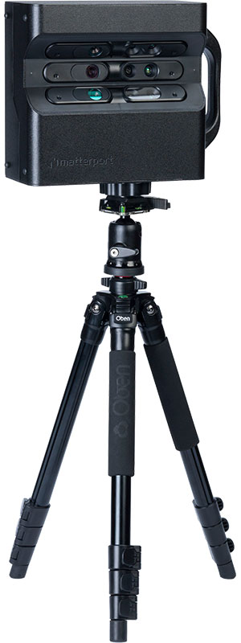
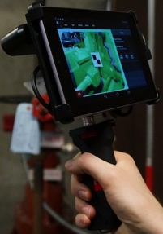
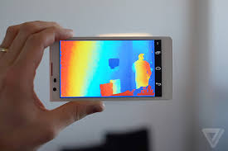
Other range sensors (some based on PrimeSense/Kinect)
DotProduct
Google Project
Tango Prototype
Matterport

Slide 48
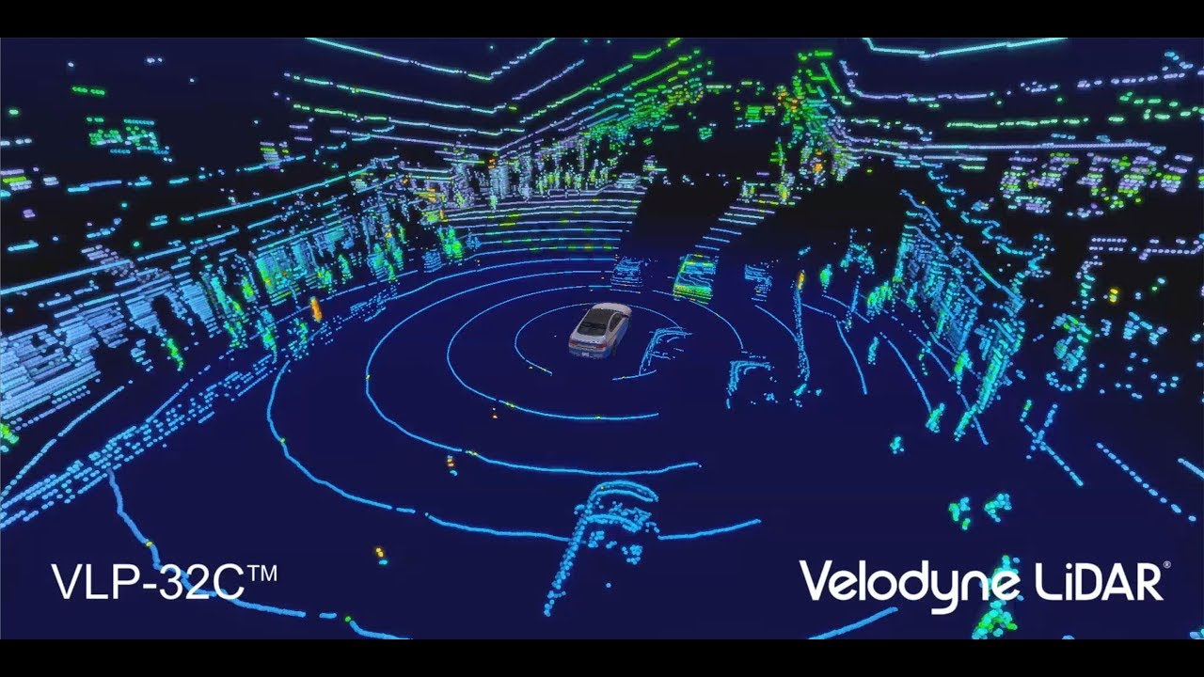
Real-time range sensors == self driving cars

Slide 49
Open datasets
KITTI <self driving>
http://www.cvlibs.net/datasets/kitti/
Waymo (just announced) <self driving>
https://waymo.com/open/
SunRGBD <indoor>
http://rgbd.cs.princeton.edu/

Slide 50
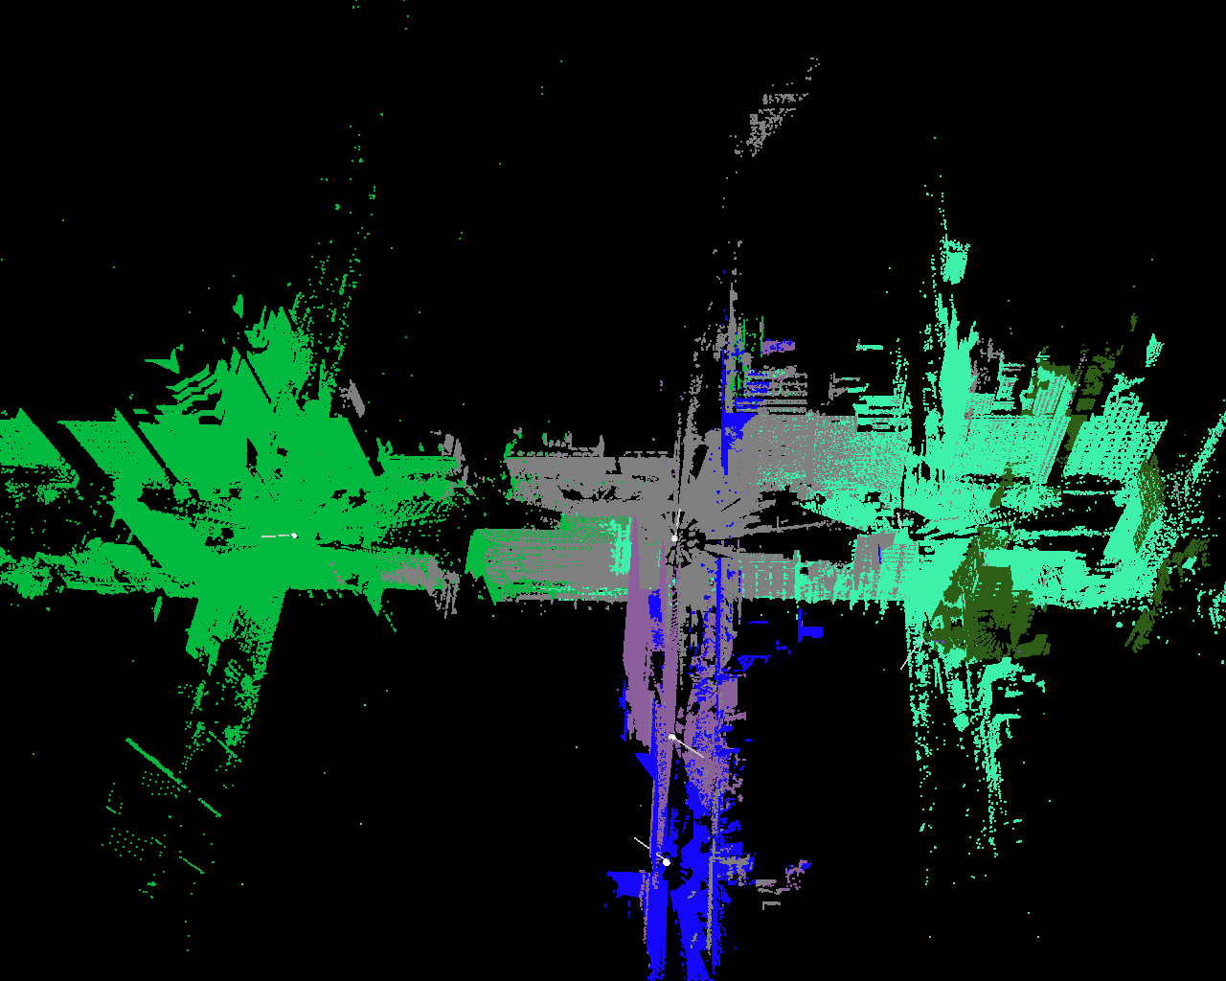
Park Avenue: Six registered scans (top view)

Slide 51
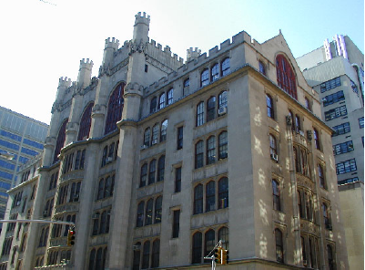
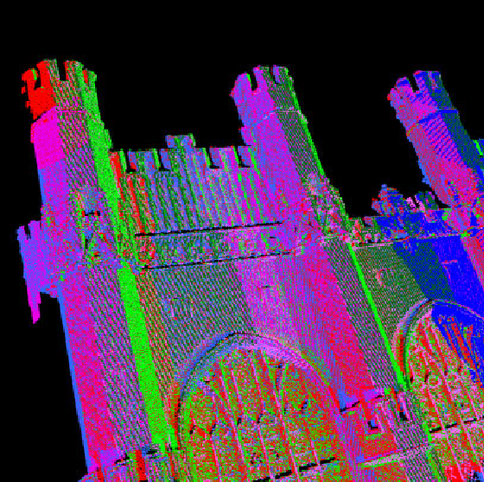
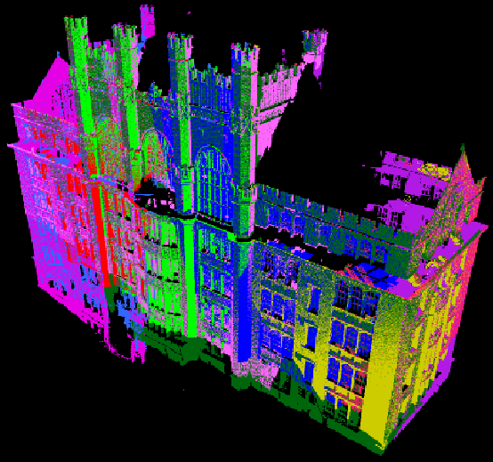
3D PHOTOGRAPHY EXAMPLE
Ten scans were acquired of façade of
Thomas Hunter Building (NYC)
Automatic registration.
Each scan has a different color.
Registration details

Slide 52
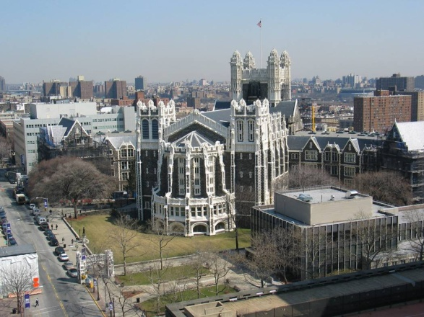
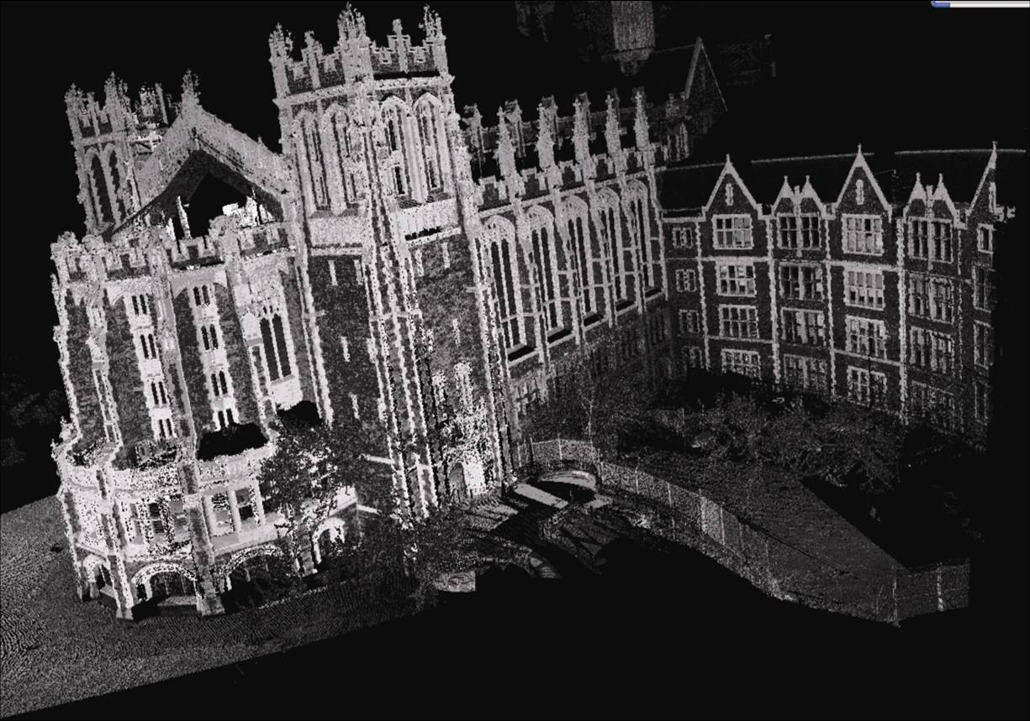
3D PHOTOGRAPHY EXAMPLE
24 scans were acquired of façade of
Shepard Hall (City College of NY)

Slide 53
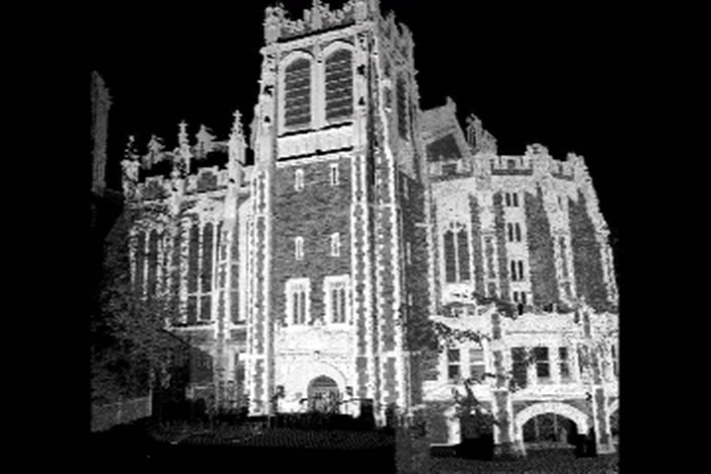
TEXTURE MAP ANIMATION

Slide 54
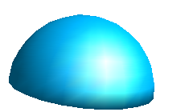

Optical Triangulation
Sources of error:
1) grazing angle,
2) object boundaries.
Sheet of
light
CCD array
Lens

Slide 55
Optical Triangulation
Sources of error:
1) grazing angle,
2) object boundaries.
Sheet of
light
CCD array
Lens

Slide 56
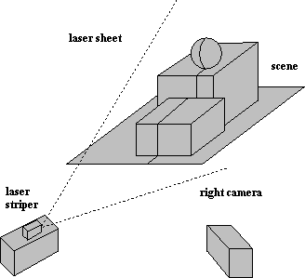
Active Optical Triangulation
Light Stripe System.
Light Plane:
AX+BY+CZ+D=0
(in camera frame)
Image Point:
x=f X/Z, y=f Y/Z
(perspective)
Yc
Zc
Xc
Image
Triangulation: Z=-D f/(A x + B y + C f)
Move light stripe or object.

Slide 57
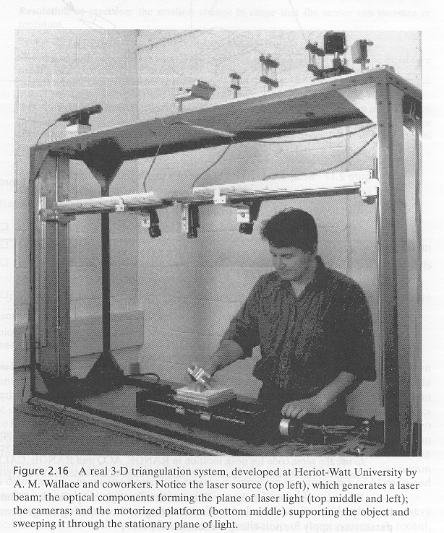
Triangulation

Slide 58
Triangulation: Moving the
Camera and Illumination
Moving independently leads to problems with focus, resolution
Most scanners mount camera and light source rigidly, move them as a unit

Slide 59
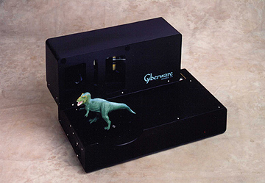
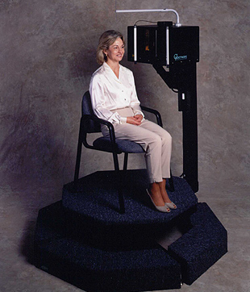
Triangulation: Moving the
Camera and Illumination

Slide 60
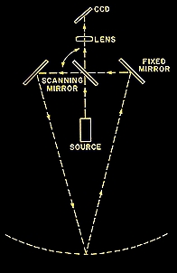

Triangulation: Moving the
Camera and Illumination

Slide 61










The Digital Michelangelo Project

Slide 62

Marc Levoy (Stanford)
calibrated motions
  pitch (yellow)
  pan (blue)
  horizontal translation (orange)
uncalibrated motions
  vertical translation
  remounting the scan head
  moving the entire gantry

Slide 63





Scanner design
4 motorized axes
truss extensions
for tall statues
laser, range camera,
white light, and color camera
Notes:
0:30

Slide 64

Scanning the David
height of gantry: 7.5 meters
weight of gantry: 800 kilograms
Notes:
2:30 through closeup of eye
0:40
So here we are scanning our “piece de resistance”
the gantry is extended to nearly its full height
If you’ve looked at our web site
you know the little story about the gantry being too short initially
because we relied on art history books for the height of the David
and they're all wrong – by 3 feet !!
so at the last minute we had to add a piece to the gantry…here
and load another few hundred pounds of ballast to the base…here – to keep the gantry from tipping over on the statue
But as you can see from the photo on the right,
we did finally reach the top of the statue
0:45
4:00 through architectural reps

Slide 65
Triangulation Scanner Issues
Accuracy proportional to working volume
(typical is ~1000:1)
Scales down to small working volume
(e.g. 5 cm. working volume, 50 μm. accuracy)
Does not scale up (baseline too large…)
Two-line-of-sight problem (shadowing from either camera or laser)
Triangulation angle: non-uniform resolution if too small, shadowing if too big (useful range: 15°-30°)

Slide 66
Triangulation Scanner Issues
Accuracy proportional to working volume
(typical is ~1000:1)
Scales down to small working volume
(e.g. 5 cm. working volume, 50 μm. accuracy)
Does not scale up (baseline too large…)
Two-line-of-sight problem (shadowing from either camera or laser)
Triangulation angle: non-uniform resolution if too small, shadowing if too big (useful range: 15°-30°)

Slide 67

Multi-Stripe Triangulation
To go faster, project multiple stripes
But which stripe is which?
Answer #1: assume surface continuity

Slide 68

Multi-Stripe Triangulation
To go faster, project multiple stripes
But which stripe is which?
Answer #2: colored stripes (or dots)

Slide 69

Multi-Stripe Triangulation
To go faster, project multiple stripes
But which stripe is which?
Answer #3: time-coded stripes

Slide 70
Time-Coded Light Patterns
Assign each stripe a unique illumination code
over time [Posdamer 82]
Time
Space

Slide 71
Laser-based Sensing
Provides solutions
  Dense & reliable
  Regular grid
But
  Complex & large point sets
  Redundant point sets
  No color information (explain this)
  Expensive, non-mobile
Adjacency info
Mesh

Slide 72
Major Issues
Registration of point sets
Global and coherent geometry
  remove redundancy
  handle holes
  handle all types of geometries
Handle complexity
  Fast Rendering

Slide 73
Representations of 3D Scenes
Geometry and Material
Complete description
Global
Geometry
Geometry and Images
Traditional texture mapping
Images with Depth
Local
Geometry
Panorama with Depth
Light-Field/Lumigraph
Scene as a light source
No/Approx.
Geometry
Facade
Panorama
False
Geometry
Colored Voxels

Slide 74


Head of Michelangelo’s David
photograph
1.0 mm computer model
Notes:
0:20
We haven’t assembled the David at full-resolution yet
Here’s a 1 mm model of the head
watertight
with color
The photograph at the left was taken with uncalibrated lighting
so the two images don’t match exactly
but hopefully you agree that we’ve basically captured the statue’s appearance

Slide 75


David’s left eye
0.25 mm model
photograph
holes from Michelangelo’s drill
artifacts from space carving
noise from laser scatter
Notes:
0:30
Here’s a closeup of David’s left eye
at the maximum resolution of our model – ¼ mm
we can see some interesting things…
These bumps
are holes from Michelangelo’s drill
so that’s real geometry
These bumps
are artifacts from space carving, the hole-filling part of our range image merging algorithm
smoothing out those artifacts, while preserving the observed surfaces, is future work
Finally, these bumps
are noise from laser subsurface scattering
Let’s zoom in some more
and look at the triangle mesh
0:45

Slide 76

IBM’s Pietà Project
Michelangelo’s “Florentine Pietà”
Late work (1550s)
Partially destroyed by Michelangelo, recreated by his student
Currently in the Museo dell’Opera del Duomo
in Florence

Slide 77


Scanner
Visual Interface “Virtuoso”
Active multibaseline stereo
Projector (stripe pattern),
6 B&W cameras, 1 color camera
Augmented with 5 extra
“point” light sources for
photometric stereo
(active shape from shading)

Slide 78
Data
Range data has 2 mm spacing, 0.1mm noise
Each range image: 10,000 points, 20×20 cm
Color data: 5 images with controlled lighting, 1280×960, 0.5 mm resolution
Total of 770 scans, 7.2 million points

Slide 79

Scanning
Final scan June 1998, completed July 1999
Total scanning time: 90 hours over 14 days
(includes equipment setup time)

Slide 80


Results

Slide 81

HUNTER COLLEGE (our work):
Intersection
line.
Each Segmented
Planar Area is
shown with different
color for clarity.
Exterior border.
Range sensing
direction.
Interior
border.
Segmented Planar Area.
Exterior and Interior borders shown.

Slide 82

HUNTER COLLEGE

Slide 83

HUNTER COLLEGE: Final result – 24 scan pairs
~600 lines per scan

Slide 84


HUNTER COLLEGE: Matching 3D with 2D imagery
3D parallelepipeds
2D rectangles
Matches shown in blue

Slide 85


HUNTER COLLEGE: Virtual (synthetic) scene views

Slide 86

Virtual (synthetic) scene views

Slide 87

Virtual (synthetic) scene views

