Slide 1
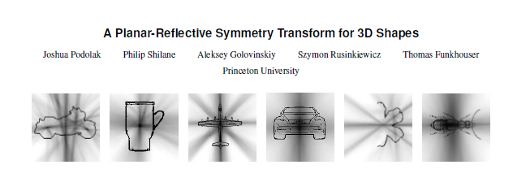
SIGGRAPH 2006
Presentation for 3D Photography Course
Ioannis Stamos

Slide 2
Overview
Planar-Reflective Symmetry Transform (PRST)
It represents perfect and imperfect symmetries
Continuous measure of reflectional symmetry of a shape wrt all possible planes

Slide 3
Why Symmetry?
Detect local features
Align
Segment
Reconstruct
  Handle Missing Data
Recognition

Slide 4
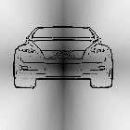
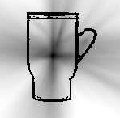
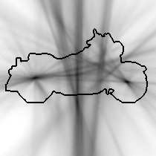
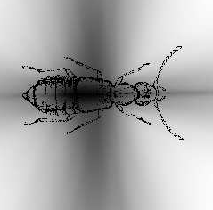
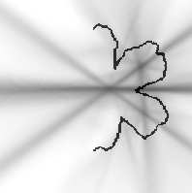
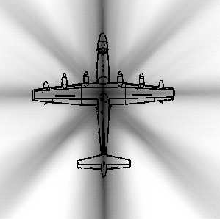
Examples in 2D
Darkest point – conceptual center
Dark lines:
reflective symmetries
Lines of reflective symmetry
The darker the more lines

Slide 5
Related Work
Perfect discrete symmetries: substring matching, octree, extended Gaussian image, generalized moments, etc.)
Imperfect symmetries: symmetry distance of a shape wrt a shape
Symmetry descriptors: shape descriptor wrt to all planes and rotations through each center of mass (Kazhdan). Used here.
Symmetry transforms: computer vision solutions: use local symmetries for segmentation, discriminating textures, or finding features in noisy images.

Slide 6


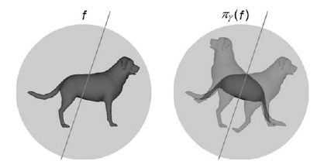
Planar Reflective Symmetry Transform (PRST)
Symmetry distance (SD) of function f (defined over d-dimensional space of points) wrt plane γ (d-dimensional): nearest function invariant wrt reflection:
0 : perfect symmetry
||f|| : antisymmetry

Slide 7

Planar Reflective Symmetry Transform (PRST)
1: perfectly symmetric wrt γ
0: perfectly anti-symmetric
0< <1: intermediate cases

Slide 8
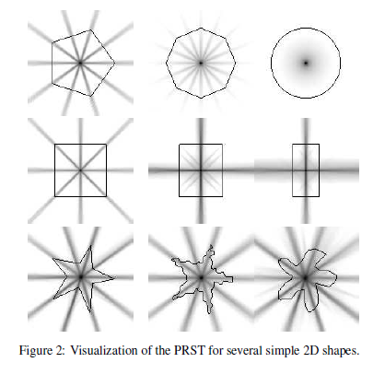
Examples in 2D
Darkness of point
corresponds
to maximum PRST value
over all
planes passing
through that point

Slide 9
Examples in 2D
Dominant points and
planes of symmetry match
human intuition
PRST takes into account
whole object =>
Not sensitive to noise
and
Varies continuously
with deformations

Slide 10



Background
Given function f in d-dim space:
f is normalized
Calculation of symmetry wrt plane γ reduces to the calculation of
the dot product between f and its reflection γ(f):

Slide 11
Background
Given function f in d-dim space:
PRST depends of how well f correlates with γ(f).
Computed as integration of product f γ(f) over bounding volume of f.
Convert f and γ(f) to volumetric functions (voxels).
Perform integration on the grid (i.e. compute sum of f[v]* γ(f)[v], for all voxels v).
Sensitivity to noise and small features

Slide 12

Gaussian Euclidean Distance Transform (GEDT)
For a model M (i.e. set of points), width σ, and arbitrary point x, GEDT is
Allows for surfaces to be slightly misaligned by the Gaussian width σ
under reflection => capture imperfect symmetries.
3D function that is 1 on the surface, and gradually drops to 0 as you move away (in or out) from it.

Slide 13
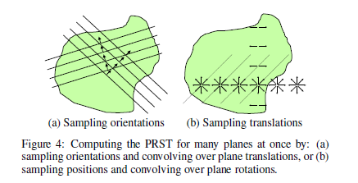
Discrete Computation on Volumetric Functions
Compute discrete version of PRST for a function f defined on a n x n x n grid. [works for every function: volume (medical data) or surfaces]
Naïve approach: O(n^3) planes on n x n x n grid
O(n^3) cost of dot product
=> O(n^6) total complexity
Using convolutions:
(a) O(n^5logn)
(b) O(n^5logn)

Slide 14
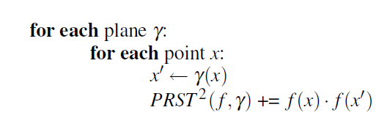
Discrete Computation on Surfaces
Brute-force:
Inefficient for sparse functions (i.e. many places in which f(x) and f(x’) is zero)

Slide 15
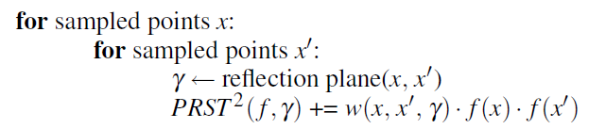
Discrete Computation on Surfaces
Importance sampling in a Monte-Carlo framework:
Pick two points x, x’ and vote for plane between them
In a 3D surface O(n^2) voxels => O(n^4) complexity

Slide 16

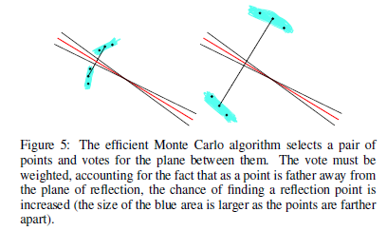

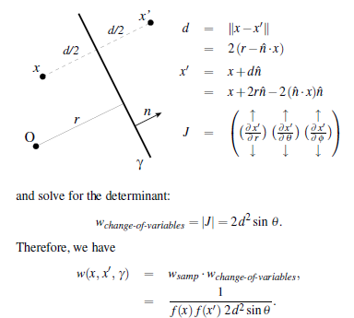

Discrete Computation on Surfaces (weighting)
Normal of plane of reflection
Overall Monte-Carlo Estimator for D(.,.) for specific plane γ

Slide 17
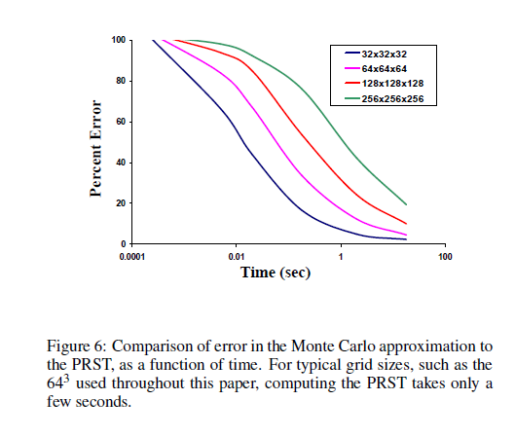
Discrete Computation on Surfaces (computation time)

Slide 18
Continuous Refinement of Local Maxima
Extract local maxima using discrete PSRT
  Find cells with higher PSRT values wrt neighbors
  Then apply thresholds
    Threshold on value of PSRT (depends on distance from center of mass): proportional to 1-r/R (R is radius of object, r is distance from center).
  Discard shallow maxima (using laplacian i.e. 2nd derivative)

Slide 19
Continuous Refinement of Local Maxima
Refine using Iterative Symmetric Points (ISA)
  Inspired by ICP
For each discrete local maximum (symmetry plane γ):
  Select a random of points on the model
  Reflect points around γ
  Find closest points on mesh
  Solve for new plane γ’ that minimized distances
    Use GEDT distance function
  Repeat

Slide 20
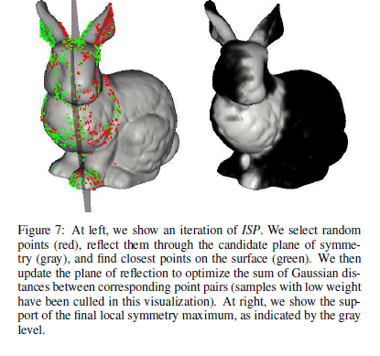
Iterative Symmetry Points

Slide 21
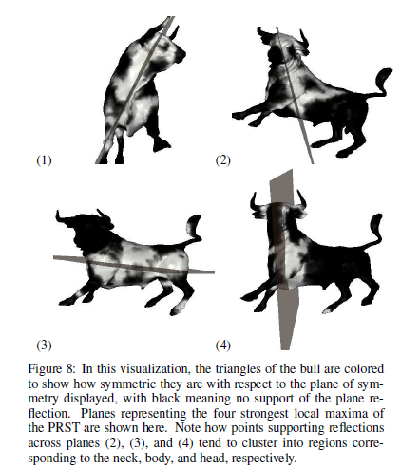
Iterative Symmetry Points

Slide 22
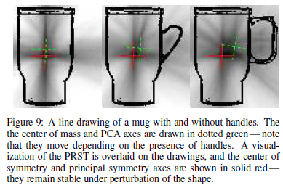
Alignment
Principal Symmetry Axes (PSA) and Center of Symmetry (COS)

Slide 23
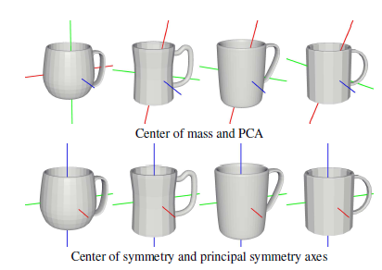
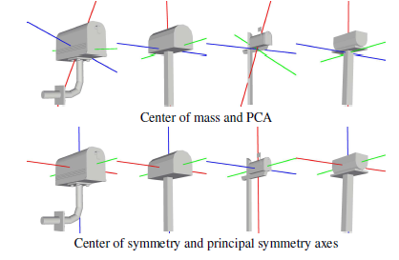
Alignment

Slide 24
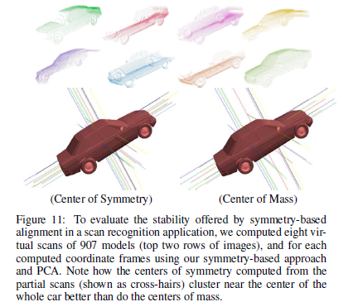
Object Recognition: Match partial range scans with model

Slide 25
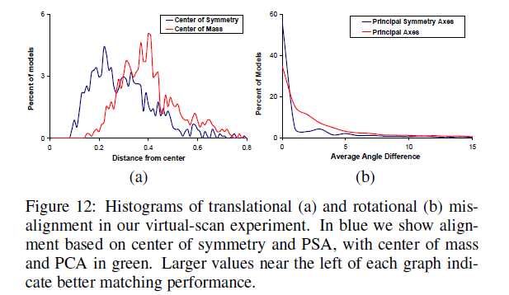
Object Recognition: Match partial range scans with model

Slide 26
Matching
Representation of shape: shape descriptor
  For recognition or classification
Dissimilarity between a pair of aligned meshes:
  L2 distance between their discrete PSRT
    Weighting corresponding bins by sqrt(sinθ) to account for different bin sizes (θ polar angle of plane)

Slide 27
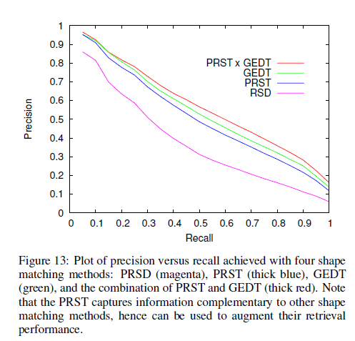
Matching
Leave-one-out
experiment from
a database of
907 models
of 92 classes

Slide 28
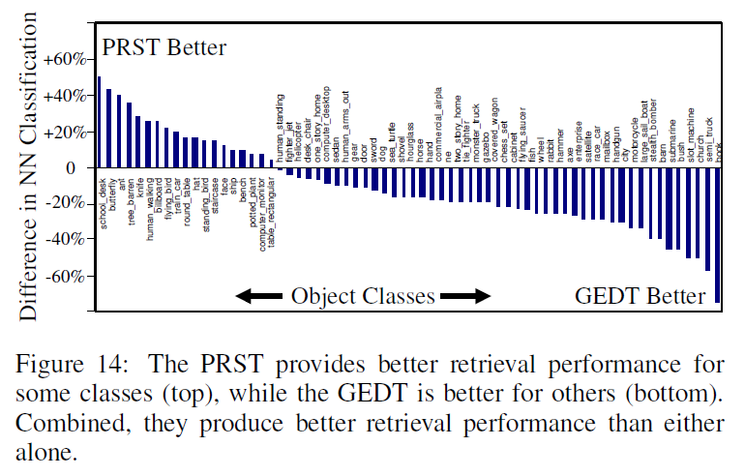
Matching

Slide 29
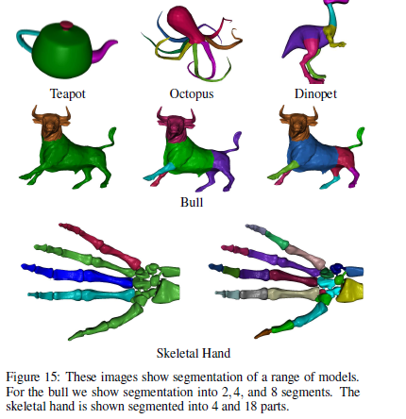
Segmentation
Decompose
based on parts
that
have
similar symmetries

Slide 30
Segmentation
Find significant maxima (planes γ) of the PSRT (m maxima)
For each point (or local face) compute the degree in which if contributes to symmetry of each plane γ
Each point can be represented by an m-dim vector
Cluster in this m-dimensional space
<Use method of Katz and Tal, 2003> (anyone to present?)

Slide 31
Viewpoint Selection
Select “good” viewpoints for 3D models
  Rapid views of large set of models
  Generation of icons
  Viewpoints for Image-Based-Rendering
  Robot Motion (Sensor Planning)

Slide 32
Viewpoint Selection
Minimize amount of symmetry in viewing direction (why?)
For each plane γ at maxima of PSRT preferred viewing direction is normal to it
Viewpoint score for a viewing direction v:
  Where u is a plane of local symmetry and M(u) is the symmetry score
Do exhaustive search in set of viewing directions

Slide 33
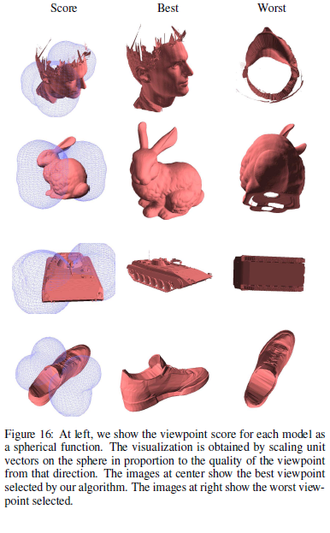
Viewpoint
Selection

Slide 34
Discussion
More symmetries to be explored (see next)
More work in segmentation (i.e. find parts of local symmetries)
PRST is a 3D to 3D mapping. Is it invertible?

